Slide 1

ANNUAL BUSINESS MEETING
NOVEMBER 15, 2024
Notes:
Business Meeting for the CPLAC SIG is scheduled for Friday, November 15th from 11:00am-12:30pm EST (Location: 413, Level 4, Downtown Marriott)

Slide 2
Agenda
Welcome!
Announcements
Member News & Celebrations
SIG Business
  Membership Update
  Elections
  Topics for Discussion
Student Travel Award
Student Poster Award Presentation
Notes:
We may move topics for discussion and elections to before the membership update so we can give Nick more time to get here.

Slide 3
Welcome (Back)!
CPLAC Board 2024
CPLAC Mission
Chair: Joanna Herres
The College of New Jersey
Vice Chair: Danielle Lindner
Stetson University
Secretary: William Ellison
Trinity University
CPLAC Treasurer: Nicholas Mian
University of New Hampshire at Manchester
Student Representative: Emily Blevins
Massachusetts General Hospital
This Special Interest Group of the Association of Behavioral and Cognitive Therapies is devoted to developing community and sharing resources for clinical psychology faculty, students, and alumni of liberal arts colleges. This group is composed of clinical scientists who are committed to promoting evidence in their teaching, research and clinical practices.
The goals of this group are to:
Provide a forum for members to communicate about issues related to conducting research in clinical psychology at liberal arts colleges.
Foster collaborations among researchers at liberal arts colleges.
Facilitate communication and sharing of resources related to teaching clinical psychology (and related topics) at the undergraduate level.
Provide support and professional networking opportunities for members, including clinical psychology graduate students interested in faculty jobs at liberal arts colleges as well as student alumni applying to graduate school and faculty positions.

Slide 4
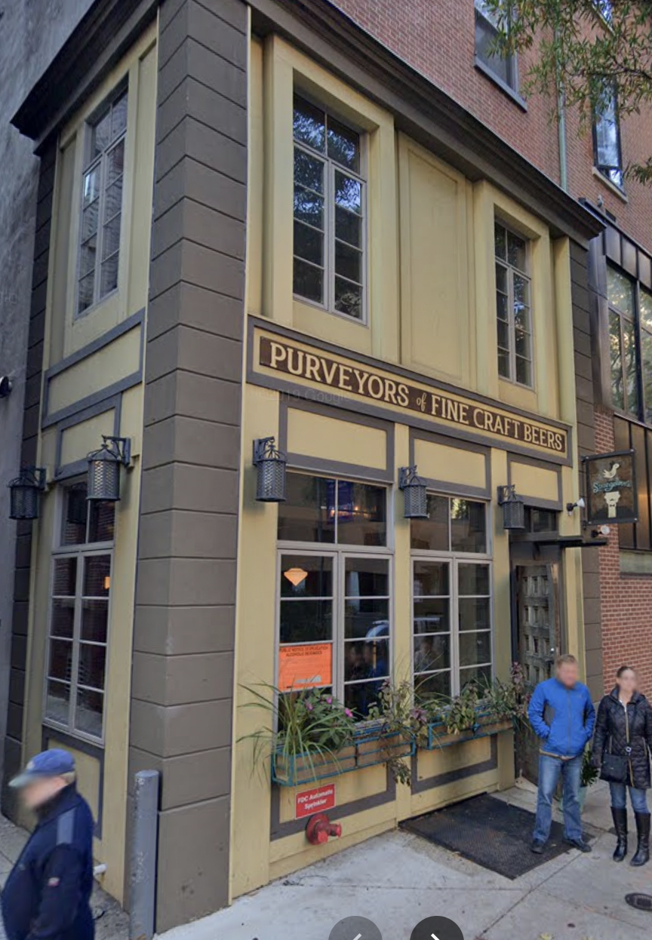
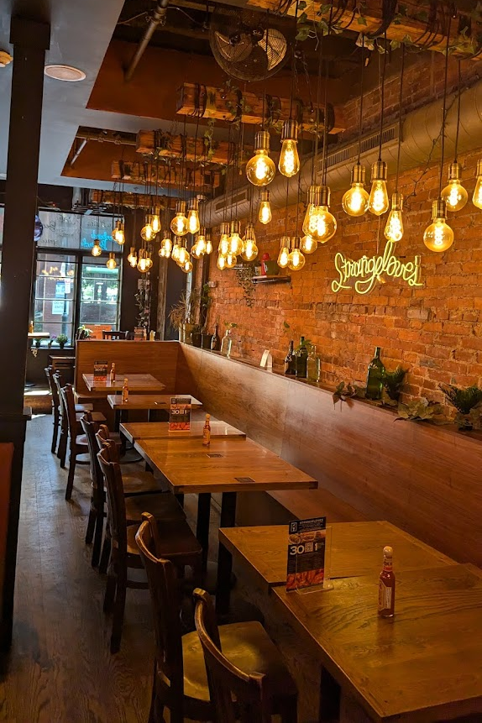

Announcements
SIG Social Event
TODAY 5-6:15 PM Strangelove’s
216 S 11th St
(Just south of Walnut)
CPLAC @ ABCT Program
https://bit.ly/CPLAC2024
Notes:
Strangelove is a 5 minute uber, 10 minute walk

Slide 5
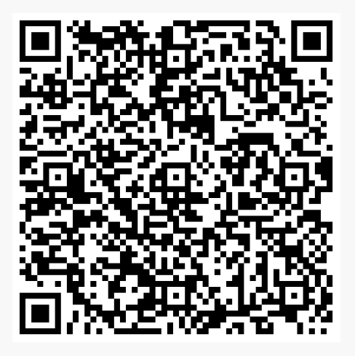
Membership Renewal
Complete 2024-2025 Membership Survey
$10 Faculty/$5 Students
Venmo: @nickmian
Cash (pay to Nick Mian)
Notes:
Nick

Slide 6
Member News & Celebrations
Amanda Halliburton
Awarded tenure and promoted to Associate Professor
Chair of the ABCT Student Membership Committee
Erin Sheets
Associate Chair of Psychology
Laura Knouse
Department Chair
Notes:
Celebrations (and in some cases, condolences)

Slide 7
Member Publications
Amanda Halliburton
Halliburton, A.E., Murray, D. W., & Ridenour, T.A. (2024). Interplay among self-regulation processes over time for adolescents in the context of chronic stress. Journal of Cognition and Development, 25(3), 386-407.
Halliburton, A.E., Hill, M.B., Hightower, J.M., Harrison, T.L., & LaFever, C.R. (2023). Mental health during COVID-19: College students’ need for structure. Journal of American College Health, 1-8.
Notes:
These might not be all publications, as we had requested info about “notable publications”
Most publications are with students as co-authors, even first authors

Slide 8
Member Publications
Joanna Herres
Bilal, N., & Herres, J. (2024). I belong: Positive perceptions of campus climate protect against PTSD following sexual assault for student minoritized due to their gender and sexuality. Journal of Interpersonal Violence.
Erin Sheets
Sheets, E. S., & Young, D. (2024). A brief, group social belonging intervention to improve mental health and academic outcomes in BIPOC and first-generation to college students. Clinical Psychological Science.

Slide 9
Member Publications
Taryn Myers
Kvaka, A., Murnen, S. K., Myers, T. A., & Nolan, E. (2024). Feminism, Femininity, and Body Concerns among Women: A Meta-Analytic Review. Sex Roles.
Swami, V., White, M. P., Voracek, M., … Myers, T. A., … & Stieger, S. (2024). Exposure and Connectedness to Natural Environments: An Examination of the Measurement Invariance of the Nature Exposure Scale (NES) and Connectedness to Nature Scale (CNS) Across 65 Nations, 40 Languages, Gender Identities, and Age Groups. Journal of Environmental Psychology.

Slide 10
Member Publications
Catherine Walker
Keigan, J., De Los Santos, B., Gaither, S. E., & Walker, D. C. (Accepted, 2024) The relationship between ethnic identification and body ideal internalization, hair satisfaction, and skin tone satisfaction in Black women. Body Image.
Competiello, S. K., Bizer, G., & Walker, D. C. (2023) The effect of stigmatizing social media on attitudes toward mental-health treatment. Social Media & Society, 9(4).
Brooks, J., Walker, D. C., & Murray, K. (2023). What can my body do for me? Seeking to improve body-functionality valuation with a guided functionality mirror exposure. Journal of American College Health.

Slide 11
SIG Poster Exposition…
(Undergraduate Students are underlined)
Preliminary Support for the Feasibility, Acceptability, and Credibility of the Behavioral Activation Life Hacks Workshop for College Students.
Michelle Okyere, Anna Jane Anderson, Kallie Cardenas, Sebastian Espinoza, Andrew Tyler, Shumyla Lopez, & Carolyn Becker (Trinity University)
Hyperfocus Mediates the Relationship Between ADHD Diagnosis and Procrastination.
Catherine Cummins, & Laura Knouse (University of Richmond)
Connecting ADHD and Procrastination Through Avoidant Automatic Thoughts.
Sam Chanenson, & Laura E. Knouse (University of Richmond)
The Effect of Alcohol Use on the Relationship Between ADHD Diagnosis, Anxiety, and Sleep Problems.
Gabby Sylvester, & Laura E. Knouse (University of Richmond)
Notes:
Danielle

Slide 12
SIG Poster Exposition…
(Undergraduate Students are underlined)
Narcissism and Student Responses to Positive and Negative Academic Feedback.
Anusha Sharma, Mason Fraser, Claire Kirk, Carolina Pinales (St. Mary's University), & William Ellison (Trinity University)
Investigating Parental Invalidation Factors, Rejection Sensitivity, and Borderline Personality Features: A Longitudinal Study.
Kimaya Reddy, & Julia McQuade (Amherst College)
Effectiveness of Self-Compassionate Writing for Reducing Body Dissatisfaction in Young Women Exposed to
Images of Idealized Bodies.
Sydney F. Goldberg, Emma R. Anderson, Carys R. Cook, Abriana G. Larson, Saima R. Siddiqui, & Kathy R.
Berenson (Gettysburg College)
Maternal & Paternal Neurodiversity-Affirming Attitudes: Concordance and Psychological Functioning.
Liza Anderson, Finley Breazeale, & Grace Binion (Furman University)
Notes:
Danielle

Slide 13
SIG Poster Exposition
(Undergraduate Students are underlined)
Digital Mental Health Interventions and Social Determinants of Health: A Selection of Feedback from
Understudied Populations.
Michelle Okyere, Shumyla Lopez, Taylur Loera, Jessica Salinas, & Lisa Smith Kilpela (Trinity University, University
of Texas Health San Antonio, & South Texas Veterans Health Care System)
Actionable Anger: The Role of Gender in Moderating Donations to Causes Promoting Racial Equity.
Eleanor A. Humphreys (Post-Baccalaureate Research Assistant, DePaul University), & Emily J. Blevins
(Massachusetts General Hospital)
Caregiver Emotion Socialization and Young Adult Wellbeing.
Waverly O. Smith, & Kathy R. Berenson (Gettysburg College)
Friend Support Preferences in College Students Predicted by Gender, Personality, and Emotion Socialization.
Thea M. Albin, Shannon C. Walker, & Kathy R. Berenson (Gettysburg College)
Notes:
Danielle

Slide 14
SIG Business

Slide 15
Membership Update
41 Members*
33 Faculty
6 Undergraduate Students
1 Graduate Students
1 Postdoc
*Was 42 at this time last year

Slide 16
Membership Update
Current Balance: $619*
Includes $167 from ABCT
Last year: Increased poster award from $100 to $150
This year: Added $250 travel award
  In response to survey results
  Awarded two grants this year
*was $1329 this time last year (historic high)

Slide 17
Elections for 2-Year Terms
Chair
  Handles official correspondence with ABCT leadership and facilitates communication with CPLAC members as needed
  Provides members with group updates and announcements
  Completes all required paperwork and forms for ABCT
  Runs the CPLAC Business Meeting
Treasurer
  Manages the group’s finances (keeps, monitors, and records funds raised and spent by the group)
  Updates the membership list (+email list and Google Group)
  Follows up with new SIG members to provide them with information about the SIG

Slide 18
Topics for Discussion
Student Travel Award
Successful first year
7 applications this year
Eligibility criteria, application process
Mentorship Program
Will continue to match mentees with mentors in 2025
Reopen peer mentorship for discussion
Webinar: Navigating the LAC Job Market
Relatively small number of graduate student members in CPLAC
SIG Sponsored Symposium Proposal
60-minute moderated panel of 3 presentations
Notes:
The survey that was sent out showed less need for mentorship at this time. Those mentees already have mentors. Nick may have matched 1 new mentee with a mentor
SIG Symposium panel to start in November 2025
Webinar in 2019… Liz Dalton provided a webinar in 2019 called “Illuminating the Liberal Arts Academic Path”

Slide 19
Student Travel Award

Slide 20

Student Travel Award
Chloe Yadav
The College of New Jersey
Eleanor Humphreys
DePaul University
Congratulations!

Slide 21
Student Poster Award

Slide 22
Student Poster Award
Michelle Okyere, Shumyla Lopez,
Taylur Loera, & Jessica Salinas
Mentor: Lisa Smith Kilpela, Ph.D.
Trinity University, University of Texas Health
Sant Antonio, & South Texas Veterans Health Care System
Digital Mental Health Interventions and Social Determinants of Health: A Selection of Feedback from Understudied Populations
Notes:
https://docs.google.com/presentation/d/17IGgXpeXpvYDp-kobzhBAwGg1EmgUYNQdZ4uHsPij6M/edit?usp=drive_link

Slide 23
Thank you for coming!!!
Reminder: SIG Happy Hour
TODAY 5:00-6:15 PM Strangelove’s
11th St., Between Walnut & Locust
Notes:
Joanna

