Slide 1

ANNUAL BUSINESS MEETING
NOVEMBER 17, 2023

Slide 2
Agenda
Welcome!
Announcements
Member News & Celebrations
SIG Business
  Membership Update
  Elections
  Discussion:
    Mentorship Program
    SIG-Sponsored Undergraduate Research Symposium
Student Poster Award Presentation

Slide 3
Welcome (Back)!
CPLAC Board 2023
CPLAC Mission
Chair: Joanna Herres
The College of New Jersey
Vice Chair: Kathy Berenson
Gettysburg College
Secretary: Amanda Halliburton
University of North Georgia
CPLAC Treasurer: Nicholas Mian
University of New Hampshire at Manchester
Student Representative: Ilana Gratch
Teachers College, Columbia University
This Special Interest Group of the Association of Behavioral and Cognitive Therapies is devoted to developing community and sharing resources for clinical psychology faculty, students, and alumni of liberal arts colleges. This group is composed of clinical scientists who are committed to promoting evidence in their teaching, research and clinical practices.
The goals of this group are to:
Provide a forum for members to communicate about issues related to conducting research in clinical psychology at liberal arts colleges.
Foster collaborations among researchers at liberal arts colleges.
Facilitate communication and sharing of resources related to teaching clinical psychology (and related topics) at the undergraduate level.
Provide support and professional networking opportunities for members, including clinical psychology graduate students interested in faculty jobs at liberal arts colleges as well as student alumni applying to graduate school and faculty positions.

Slide 4

Announcements
SIG Happy Hour/Social Event
TODAY 5-6:15 PM Daniel’s Broiler
808 Howell St, Seattle, WA 98101
(Located in the Hyatt Regency)
CPLAC @ ABCT
http://bit.ly/CPLAC2023

Slide 5
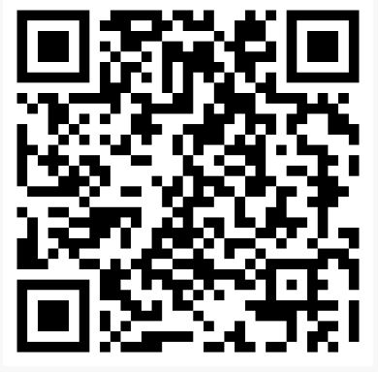
Membership Renewal
Complete 2023-2024 Membership Survey
$10 Faculty/$5 Students
Venmo: @nickmian (also link in member survey)
Cash (pay to Joanna Herres)

Slide 6
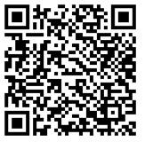
Clinical Practice Statement
This year, members collaborated on writing a CPLAC Clinical
Practice Statement (linked via the QR code).
The statement affirms the value of engaging in clinical practice as a faculty member at a liberal arts college.
Thanks to the following members who contributed:
Kerstin Blomquist Elizabeth Dalton Amanda Halliburton Joanna Herres Danielle Linder John Monopoli Erin Sheets Lauren Stutts Michael Wheaton
Notes:
Thanks especially to Kerstin Blomquist for spearheading the task.
https://cplac.files.wordpress.com/2023/07/cplac-clinical-practice-statement.pdf

Slide 7
Member News & Celebrations
Lori Hilt, Lawrence University
Appointed to an endowed professorship
Received 2023 Award for Excellence in Scholarship
Laura Knouse, University of Richmond
Promoted to full professor
John Monopoli, Susquehanna University
Opened an LLC
Susan Wenze, Lafayette College
Received Fulbright Scholar Award
Danielle Lindner (& student Andrea Mingo), Stetson University
Participated in Council on Undergraduate Research Scholars Transforming
Through Research (CUR STR) program – & she recommends it to others!

Slide 8
Member News & Celebrations
Publications
Differential associations and concordance across measures of parent emotion socialization: The role of parent and adolescent emotion dysregulation. (Social Development; Julia McQuade and colleagues)
The effectiveness of anxiety interventions for young children: A meta-analytic review. (Journal of Child and Family Studies; Nick Mian and colleagues)
What do we know (or NOT know) about school shooter response training? (The Behavior Therapist; Stephanie Ernestus and colleagues)

Slide 9
Member News & Celebrations
Publications, cont.
Ecological momentary assessment of postpartum outcomes in mothers of multiples: Lower maternal-infant bonding, higher stress and more disrupted sleep. (Archives of Women’s Mental Health; Susan Wenze and colleagues)
Randomized controlled trial of a mindfulness mobile application for ruminative adolescents (Journal of Clinical Child and Adolescent Psychology; Lori Hilt and colleagues)
Thriving in College with ADHD: A Cognitive-Behavioral Skills Approach (clinician manual published by Laura Knouse and colleagues)

Slide 10
Member News & Celebrations
Publications, cont.
Taryn Myers had 2 publications with colleagues:
Body appreciation around the world: Measurement invariance of the Body Appreciation Scale-2 (BAS-2) across 65 nations, 40 languages, gender identities, and age groups (Body Image)
“Your body is not representative of who you are”: Exploring the relationships between feminist attitudes, feminist identity, and responses to fat talk (Psychology of Women Quarterly)

Slide 11
Member News, cont: Publications
Publications, cont.
Joanna Herres had 3 publications with colleagues:
Factors associated with perceived stress and depressive symptoms among college students during the COVID-19 pandemic (Journal of American College Health)
Combining Attachment Based Family Therapy and Cognitive Behavior Therapy to Improve Outcomes for Adolescents with Anxiety (Frontiers in Psychology)
Multidisciplinary argument for the decriminalization of drugs (Journal of Addictions and Offender Counseling)

Slide 12
Member News, cont: Publications
Publications, cont.
Rebecca Shiner had 5 (!!) publications with colleagues:
The development of temperament, personality traits, and coping in childhood and adolescence (Cambridge Handbook of the Development of Coping)
The relations between narrative identity and personality pathology among clinical adolescents: Findings from a multi-ethnic Asian sample (Journal of Personality Assessment)
Personality development among immigrant and non-immigrant adolescents in the context of a great economic recession: Disruption or maturation? (European Journal of Personality)
A person-centered approach to resilience and vulnerability in emerging adulthood: Predictions from parenting and personality in adolescence (Development and Psychopathology)
The relationship between veterans’ narrative processing of their service experiences and post-traumatic stress disorder symptoms, daily functioning and well-being (Journal of Traumatic Stress)

Slide 13
Member News & Celebrations
Student Publications
Naomi Curran (Mentor: Lori Hilt) published her senior thesis entitled: Evaluating the moderating effect of gender on adolescents’ internalizing symptoms throughout the first wave of COVID-19 (Youth and Society)
Hope Rutter (Mentor: Kathy Berenson) won the 2020 CPLAC student poster award, published her project entitled: Self-compassion and women’s experience of social media content portraying body positivity and appearance ideals (Psychology of Popular Media)
Laura Knouse published a paper with five undergraduate co-authors entitled: Avoidant automatic thoughts are associated with task avoidance and inattention in the moment (Cognitive Therapy and Research)

Slide 14
SIG Poster Exposition
The Relation of Child ADHD Symptoms and Social Impairments: The Moderating Role of Positive Emotion Dysregulation
Mel Arthur,* Kimaya A. Reddy,* and Julia D. McQuade, Amherst College (*shared first authorship)
How do Ethnic Identity and Microaggressions Predict Moment to Moment Emotion and Self-Concept?
Mason Fraser, Mona Mirpour, Juyoung Yun, Saivone Sanchious, Autumn Lucas-Marinelli, and William Ellison, Trinity University
Ecological Levels of Influence on Coping Following Campus Sexual Assault
Kayla Martins and Joanna Herres, The College of New Jersey
The Relationship of Anxiety, Depression, and Suicidal Ideation Screeners to a Psychosis Risk Screener in Mental Health Involved Adolescents and Young Adults
Tara M. Mullen and Ashley M. Shaw, Bowdoin College, Eb Bernier, David M. Weiss, Jonathan T. Fanburg, Deborah Q. Hagler,
Kathleen A. Herlihy, and Paul L. Hyman, MaineHealth, Kristen A. Woodberry, MaineHealth and Tufts University School of Medicine
Pathways Linking Self-Compassion, Emotional Clarity, Trauma, and Stress-Related Outcomes in a College Students Sample
Janelle S. Peifer and Yueyi Fan, University of Richmond, Anna Lauer Roy, Center for Inclusive Therapy + Wellness, Jordan Green, University of Michigan
Baseline Readiness to Change is Not Associated with Symptom Outcomes During Treatment with a Digital Version of the Unified Protocol
Brian E. Zirkel, Daniella Spencer-Laitt, and Audrey J. Hey, Boston University

Slide 15
SIG Business

Slide 16
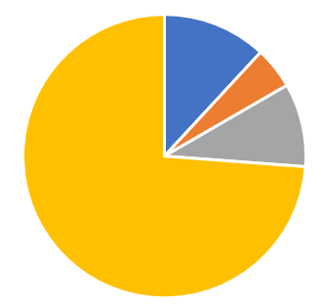
Membership Update
42 Members*
73.9% Faculty
9.5% Undergraduate Student
11.9% Graduate Student
4.7% Postdoc
*Removed 28 former members from Google Group who had not paid dues, perhaps for multiple years

Slide 17
Membership Update
42 Members
73.9% Faculty
9.5% Undergraduate Student
11.9% Graduate Student
4.7% Postdoc
Current balance: $1,329
Includes recent “gift” of $166 from ABCT
Increasing student award from $100 to $150 due to high balance

Slide 18
Elections for 2-Year Terms
Vice Chair
  Coordinates review for SIG Poster Exposition
  Plans a social event for the annual meeting
  Fulfills the role of the Chair if they are unable
Secretary
  Responsible for official “recordings” (e.g., meeting minutes)
  Manages the website (e.g., updates info as needed)
Student Representative
  Advocates for, represents, and communicates the interests and needs of the student members
  Assists the other officers in official tasks as needed
  (e.g., helping to recruit more student members)
Notes:
Danielle Lindner at Stetson was nominated and has agreed to run for VC.
Bill Ellison at Trinity College agreed to run for secretary.

Slide 19
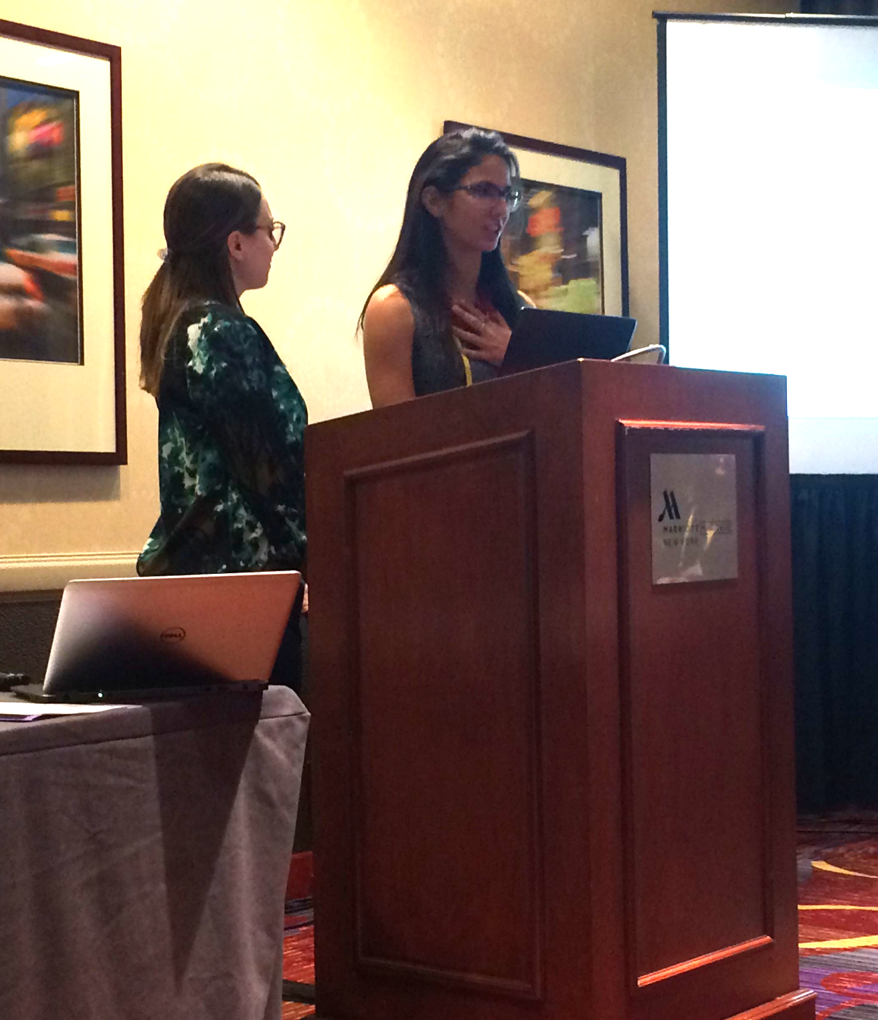
Topics for Discussion
Mentorship Program
Open for discussion- can be re-started in 2024
SIG Sponsored Symposium Proposal
60-minute moderated panel of 3 presentations
1st author/presenter must be an undergraduate or presenting research conducted as an undergraduate student
Integrated into poster submission & review process (with an earlier deadline)
2016 Student Poster Award Winners Monica Abdul-Chani & Gabriella Ponzini
Notes:
Deadline for symposium would move the submissions earlier in the summer since we’d have to notify ABCT by July 28th

Slide 20
Student Poster Award

Slide 21

Student Poster Award
Mel Arthur & Kimaya A. Reddy
(shared first authorship)
Mentor: Julia D. McQuade, Ph.D.
Amherst College
The Relation of Child ADHD Symptoms and Social Impairments: The Moderating Role of
Positive Emotion Dysregulation
Notes:
https://docs.google.com/presentation/d/10DQjB7txxlWi0t-alxeR6tIFTq4FrFjQu7VY6HINlyA/edit?usp=sharing
https://drive.google.com/file/d/1pGiYhQH385N6YjmCl5hYPKqV40Wia6mm/view?usp=drive_link

Slide 22
Thank you for coming!!!
Reminder: SIG Happy Hour
NOW 5:00-6:15 PM Daniel’s Broiler Room on 2nd floor
Also, renew Membership:

