Slide 1

ANNUAL BUSINESS MEETING
NOVEMBER 19, 2022

Slide 2
Agenda
Welcome!
Announcements
Member News & Celebrations
SIG Business
Membership Update
Elections
Proposal & Discussion:
SIG-Sponsored Undergraduate Research Symposium
Student Poster Award Presentation

Slide 3
Welcome (Back)!
CPLAC Board 2022
CPLAC Mission
Chair: Laura Sockol
Davidson College
Vice Chair: Kathy Berenson
Gettysburg College
Secretary: Amanda Halliburton
University of North Georgia
CPLAC Treasurer: Jumi Hayaki
College of the Holy Cross
Student Representative: Ilana Gratch
Teachers College, Columbia University
This Special Interest Group of the Association of Behavioral and Cognitive Therapies is devoted to developing community and sharing resources for clinical psychology faculty, students, and alumni of liberal arts colleges. This group is composed of clinical scientists who are committed to promoting evidence in their teaching, research and clinical practices.
The goals of this group are to:
Provide a forum for members to communicate about issues related to conducting research in clinical psychology at liberal arts colleges.
Foster collaborations among researchers at liberal arts colleges.
Facilitate communication and sharing of resources related to teaching clinical psychology (and related topics) at the undergraduate level.
Provide support and professional networking opportunities for members, including clinical psychology graduate students interested in faculty jobs at liberal arts colleges as well as student alumni applying to graduate school and faculty positions.

Slide 4

Announcements
SIG Happy Hour/Social Event
TODAY 6-7 PM The Long Room
120 West 44th St.
(Between 6th & 7th)

Slide 5
Announcements
SIG Happy Hour/Social Event
TODAY 6-7 PM The Long Room
120 West 44th St.
(Between 6th & 7th)
CPLAC @ ABCT
https://bit.ly/CPLAC2022

Slide 6


Membership Renewal
Complete 2022-2023 Membership Form
https://bit.ly/CPLACMembership
$10 Faculty/$5 Students
Venmo: @JHayaki
PayPal: JumiHayaki@hotmail.com
Cash

Slide 7
Member News & Celebrations
Joanna Herres, The College of New Jersey
Tenure & Promotion to Associate Professor
License to practice in PA

Slide 8
Member News & Celebrations
Joanna Herres, The College of New Jersey
Tenure & Promotion to Associate Professor
License to practice in PA
Lori Hilt, Lawrence University
Promotion to Full Professor
Department Chair

Slide 9
Member News & Celebrations
Joanna Herres, The College of New Jersey
Tenure & Promotion to Associate Professor
License to practice in PA
Lori Hilt, Lawrence University
Promotion to Full Professor
Department Chair
Taryn Myers, Virginia Wesleyan University
Promotion to Full Professor

Slide 10
Member News & Celebrations
Joanna Herres, The College of New Jersey
Tenure & Promotion to Associate Professor
License to practice in PA
Lori Hilt, Lawrence University
Promotion to Full Professor
Department Chair
Taryn Myers, Virginia Wesleyan University
Promotion to Full Professor
Danielle Lindner, Stetson University
Program Director of Gender & Sexuality Studies
Hamilton Lottery Winner

Slide 11
Member News & Celebrations
Sue Wenze: Fulbright Scholar Award to Portugal (Spring 2023)

Slide 12
Member News & Celebrations
Sue Wenze: Fulbright Scholar Award to Portugal (Spring 2023)
Stephanie Ernestus, C. J. Fleming, Sue Wenze & Kerstin Blomquist: Publication in The Behavior Therapist: The future of mental health care: Why we need clinical competencies for undergraduate psychology majors.

Slide 13
Member News & Celebrations
Sue Wenze: Fulbright Scholar Award to Portugal (Spring 2023)
Stephanie Ernestus, C. J. Fleming, Sue Wenze & Kerstin Blomquist: Publication in The Behavior Therapist: The future of mental health care: Why we need clinical competencies for undergraduate psychology majors.
Julia McQuade: Co-edited a special issue in JCAP : Transdiagnostic Implications of Parental Socialization of Child and Adolescent Emotions

Slide 14
Member News & Celebrations
Sue Wenze: Fulbright Scholar Award to Portugal (Spring 2023)
Stephanie Ernestus, C. J. Fleming, Sue Wenze & Kerstin Blomquist: Publication in The Behavior Therapist: The future of mental health care: Why we need clinical competencies for undergraduate psychology majors.
Julia McQuade: Co-edited a special issue in JCAP : Transdiagnostic Implications of Parental Socialization of Child and Adolescent Emotions
Student Elsa Hammerdahl (Mentors: Lori Hilt & Amanda Draheim) awarded a Psi Chi Undergraduate Research Award for Role of Inhibition in Mindfulness and Rumination

Slide 15
Member News & Celebrations
Sue Wenze: Fulbright Scholar Award to Portugal (Spring 2023)
Stephanie Ernestus, C. J. Fleming, Sue Wenze & Kerstin Blomquist: Publication in The Behavior Therapist: The future of mental health care: Why we need clinical competencies for undergraduate psychology majors.
Julia McQuade: Co-edited a special issue in JCAP : Transdiagnostic Implications of Parental Socialization of Child and Adolescent Emotions
Student Elsa Hammerdahl (Mentors: Lori Hilt & Amanda Draheim) awarded a Psi Chi Undergraduate Research Award for Role of Inhibition in Mindfulness and Rumination
2021 Student Poster Award Winner Berny Pereda (Mentor: Joanna Herres) attending Clinical Psychology Ph.D. program at SUNY Buffalo

Slide 16
Member News & Celebrations
Sue Wenze: Fulbright Scholar Award to Portugal (Spring 2023)
Stephanie Ernestus, C. J. Fleming, Sue Wenze & Kerstin Blomquist: Publication in The Behavior Therapist: The future of mental health care: Why we need clinical competencies for undergraduate psychology majors.
Julia McQuade: Co-edited a special issue in JCAP : Transdiagnostic Implications of Parental Socialization of Child and Adolescent Emotions
Student Elsa Hammerdahl (Mentors: Lori Hilt & Amanda Draheim) awarded a Psi Chi Undergraduate Research Award for Role of Inhibition in Mindfulness and Rumination
2021 Student Poster Award Winner Berny Pereda (Mentor: Joanna Herres) attending Clinical Psychology Ph.D. program at SUNY Buffalo
Gabrielle Ilagan won ABCT's Student Research Grant

Slide 17
SIG Poster Exposition
Parent-Report of Child Rumination
Georgia Chi-Ngai Chau, Grace Fox, & Lori Michelle Hilt, Ph.D., Lawrence University
Emotional Awareness and Self-Compassion Predict Well-Being
Yueyi Fan, Kristjen B. Lundberg, Ph.D., Janelle S. Peifer, Ph.D., & Laura E. Knouse, Ph.D., University of Richmond
Rumination and the Gut Microbiome: Effects of a Brief Mindfulness Intervention
Moeka Kamiya, B.A., & Lori M. Hilt, Ph.D, Lawrence University
Clinical Competencies for Undergraduates: Survey of Graduate School Faculty Illustrates the Need for Improved Undergraduate Training
Robin Kennedy, Kerstin K. Blomquist, Ph.D., Susan Wenze, Ph.D., Stephanie Ernestus, Ph.D., & CJ Fleming, Ph.D.
Furman University, Lafayette College, Stonehill College, & Elon University
“I don’t want to put this on them”: Disconnect between College Students and their Parents about Anxiety
Ariana Lencioni, Annabelle Rutherford, & Lillian Reuman, Ph.D., Stonehill College
Associations Between Social Reactions from Romantic Partners to Sexual Assault Disclosure and PTSD Symptoms
Alexis Lovallo, Snehi Mukkamalla, Kayla Martins, & Joanna Herres, Ph.D., The College of New Jersey
Health Disparities within the Hispanic/Latinx Community through an Intersectional Lens: Ethnicity and Gender
Jose D. Martinez Quiroz, Siena A. Senn, B.A., & Lauren A. Stutts, Ph.D., Davidson College
The Impact of Single-Session Gratitude Interventions on Stress and Affect
Heidi H. Meyer & Lauren A. Stutts, Ph.D., Davidson College
Savoring Positive Emotions Reduces Pre-Existing Worry in Generalized Anxiety Disorder: An Interventional Experiment
Felicia Rosen, B.A. & Lucas S. LaFreniere, Ph.D., Skidmore College
Gender Differences in Perception of the Body Positivity Movement
Olivia Shenkle, B.S. & Danielle Lindner, Ph.D., Stetson University
Forgiveness of Self, Others, and Situations in People with Obsessive Compulsive Disorder
Julia Greenblatt, Hesperus Di Properzio, B.A., Desiree Webb, B.A., Amanda Peng, Sarah Kopyto, & Michael Wheaton, Ph.D., Barnard College
What Does “Avoidance Mode” Feel Like? The Association Between Avoidance Awareness and Negative Affect in the Moment
Mamie Ziegler, Ilana Lavine, Hoor Ul Ain, & Laura E. Knouse, Ph.D., University of Richmond

Slide 18
SIG Business

Slide 19
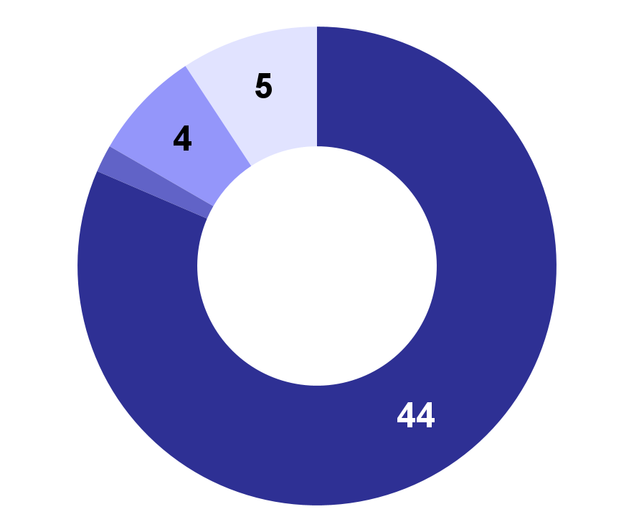
Membership Update
54 Members
81% Faculty
9% Undergraduate Student
7% Graduate Student
2% Postdoc

Slide 20
Membership Update
54 Members
81% Faculty
9% Undergraduate Student
7% Graduate Student
2% Postdoc
Budget: $1459.06

Slide 21
Membership Update
54 Members
81% Faculty
9% Undergraduate Student
7% Graduate Student
2% Postdoc
Budget: $1459.06
Mentorship Program
5 Member Pairs

Slide 22
Elections
Vice Chair & Treasurer
Submit Nominations (Self-nominations are welcome!)

Slide 23
Elections
Vice Chair & Treasurer
Submit Nominations (Self-nominations are welcome!)
Proposal: Change terms of Chair & Vice Chair positions.
Current: One year as Vice Chair followed by one year as chair.
Proposal: Two year terms for Chair & Vice Chair, elected in alternating years.

Slide 24
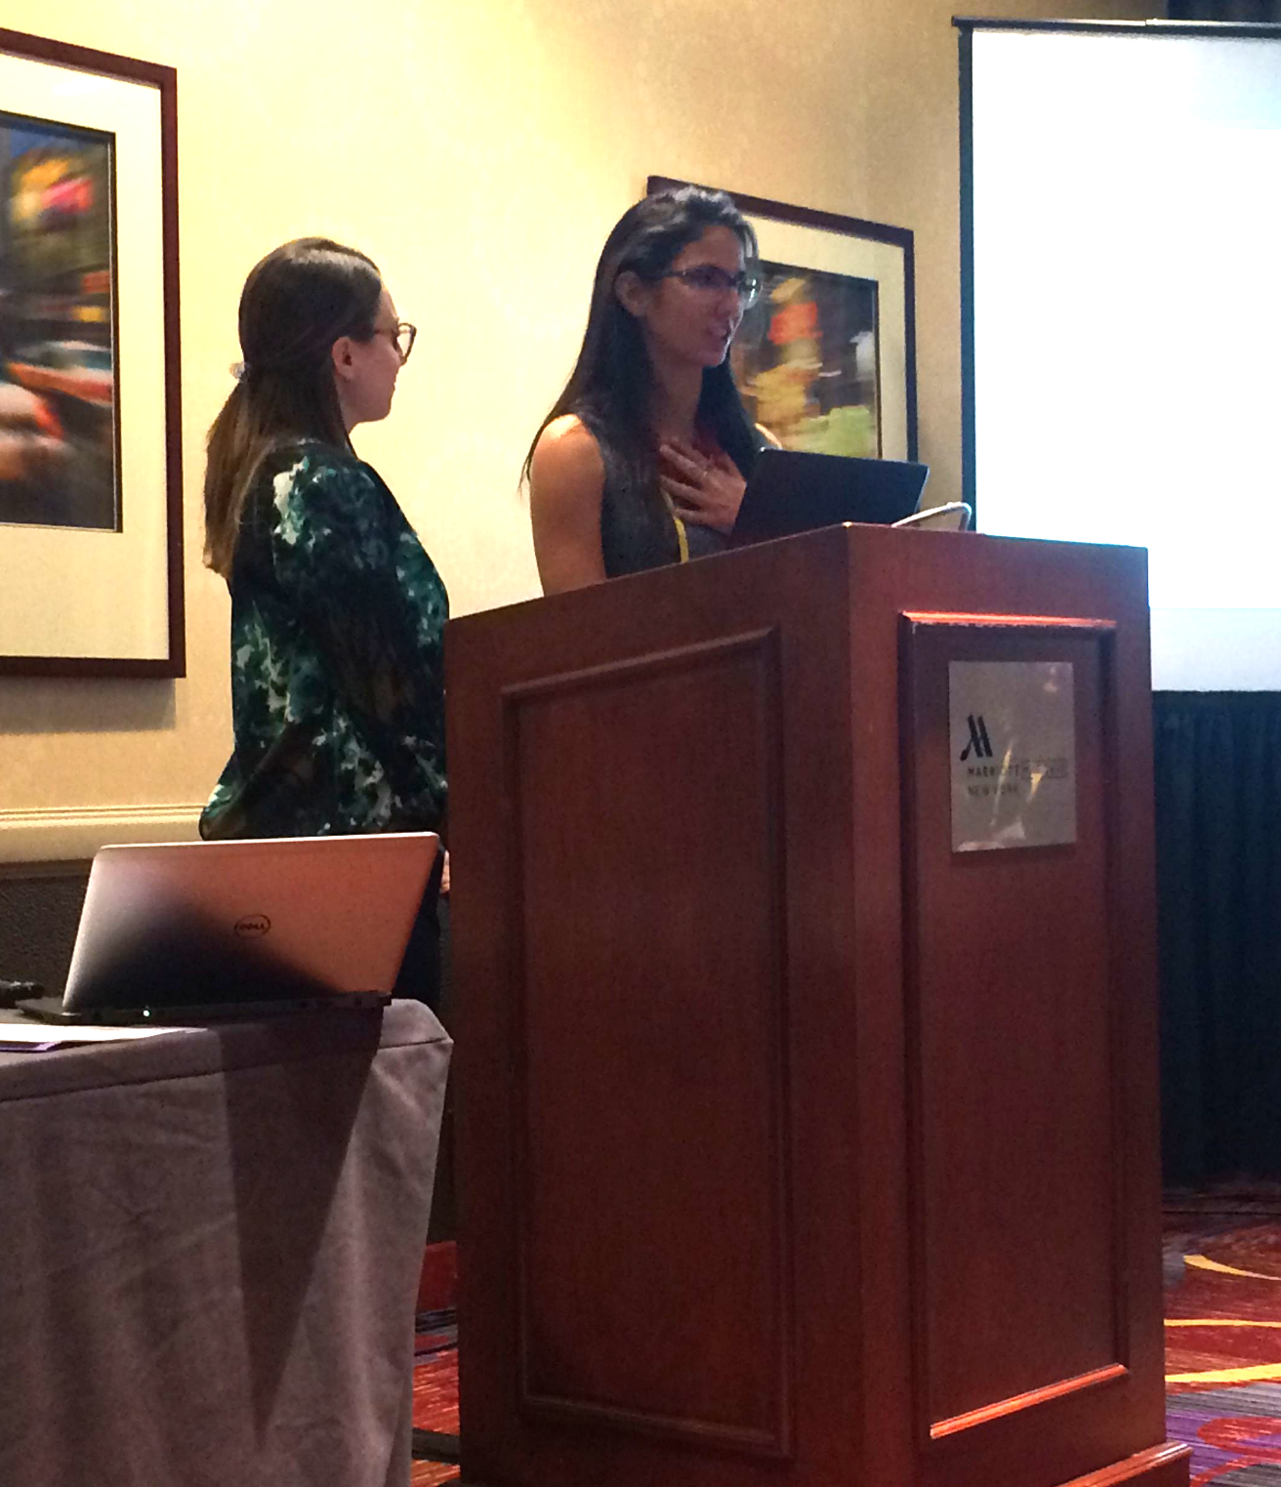
SIG Sponsored Symposium Proposal
Moderated panel of 3-4 undergraduate* research presentations.
Integrated into poster submission & review process.
* First author/presenter must be an undergraduate student or presenting research conducted as an undergraduate student.
2016 Student Poster Award Winners Monica Abdul-Chani & Gabriella Ponzini

Slide 25
Student Poster Award

Slide 26

Student Poster Award
Felicia Rosen
Mentor: Lucas S. LaFreniere, Ph.D.
Skidmore College
Savoring Positive Emotions Reduces Pre-Existing Worry in Generalized Anxiety Disorder:
An Interventional Experiment

