Slide 1
Involving Students in Research:
Increasing Diversity
Laura E. Sockol, Ph.D.
Davidson College

Slide 2
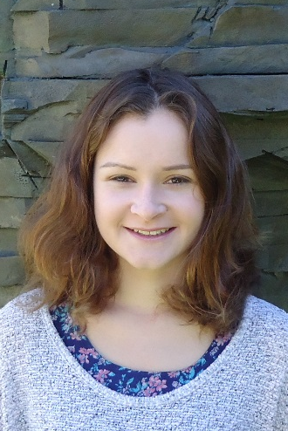

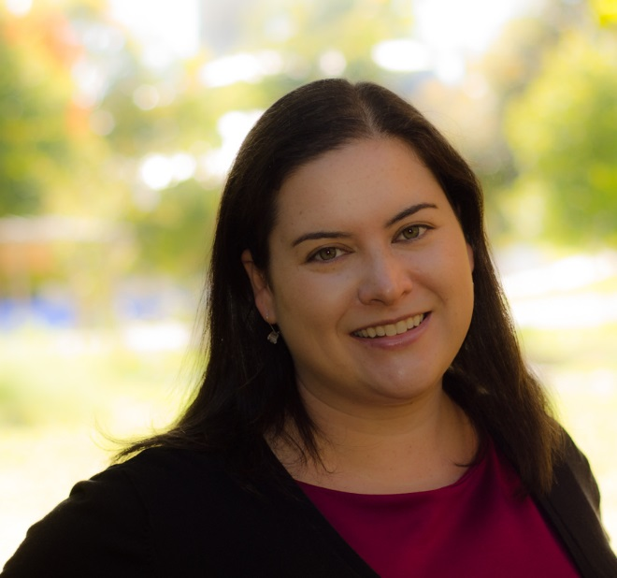


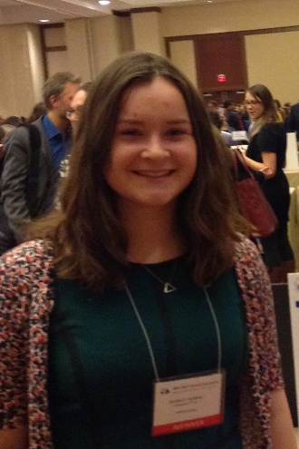

Slide 3
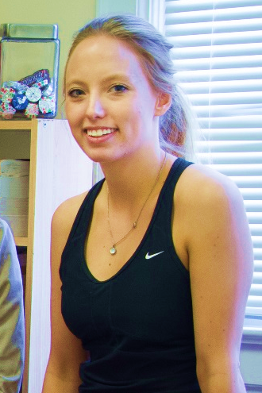

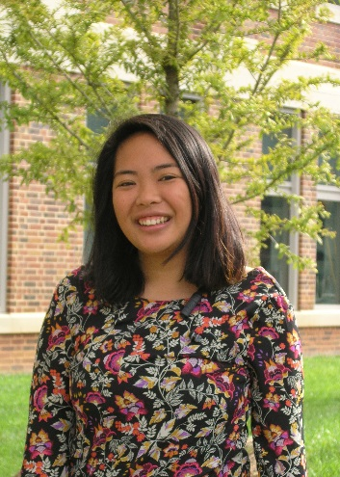
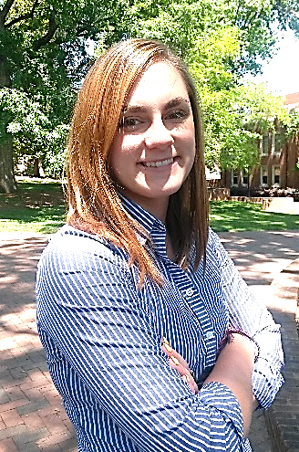
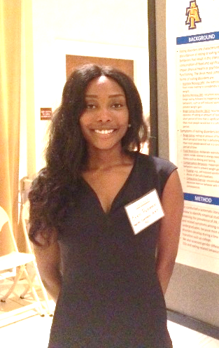



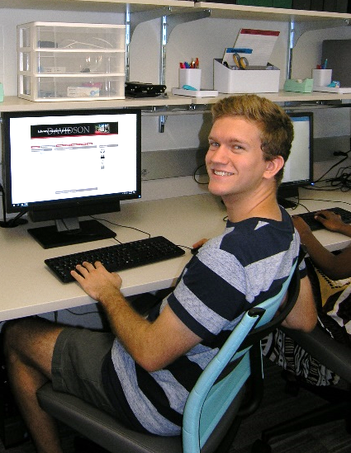
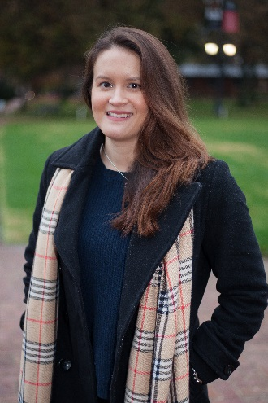
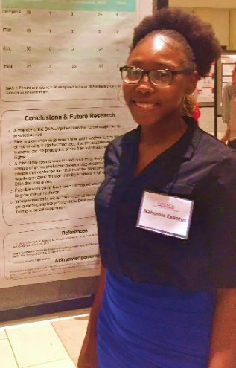

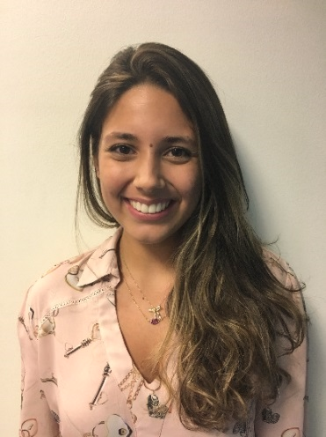
79% women
vs. 50%
43% domestic & international students of color
vs. 25% domestic students of color, 6% international students
31% first-generation college students
vs. 10%
14% attend other institutions

Slide 4
Strategies
Decide Diversity Matters
Outreach & Recruitment
Structured Application Process
Track Data

