Slide 1
Undergraduate Research
Different Pathways to Introducing undergraduates to the process of psychological science
Taryn A. Myers, Ph.D.
Batten Associate Professor and Chair
Department of Psychology
Virginia Wesleyan University

Slide 2
Pathways to Involving Students in Research
As Undergraduate Research Assistants
Student-Designed Research Independent Study
Required Capstone Research Project

Slide 3
Undergraduate Research Assistants

Slide 4
Finding Students to Serve as R.A.s
Recruiting
  Advertise
    In classes
    Via email
  Talk one-on-one
Advising
  Students will seek out experience
    Your research
    Class projects
  Advise those interested in graduate school

Slide 5
Selecting Students
Your own knowledge of students
Recommendations of colleagues
Criteria
  Interest
  Dedication
  Performance?
  What criteria do you use?

Slide 6

Integrating students into existing research
Determine their interests
Use them where you need them!
Ways to integrate
  Survey question entry (SurveyMonkey)
  Data collection
  Database creation
  Data entry
  Data analysis
  Writing
  Presentations

Slide 7
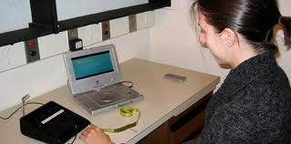
Integrating students into existing research
Considerations
  Deadlines
  Workload
  Compensation
    Course credit
    Monetary
    Letters of recommendation
  Evaluation
  Agreement
    Formal
    Informal

Slide 8
Research Independent Studies

Slide 9

Research Independent Studies
Expand upon class projects
Help the student choose an area of your research
Supervise a related area of research
Think about timing
  During the semester
  Over the summer (Summer High Impact Practice Program)

Slide 10
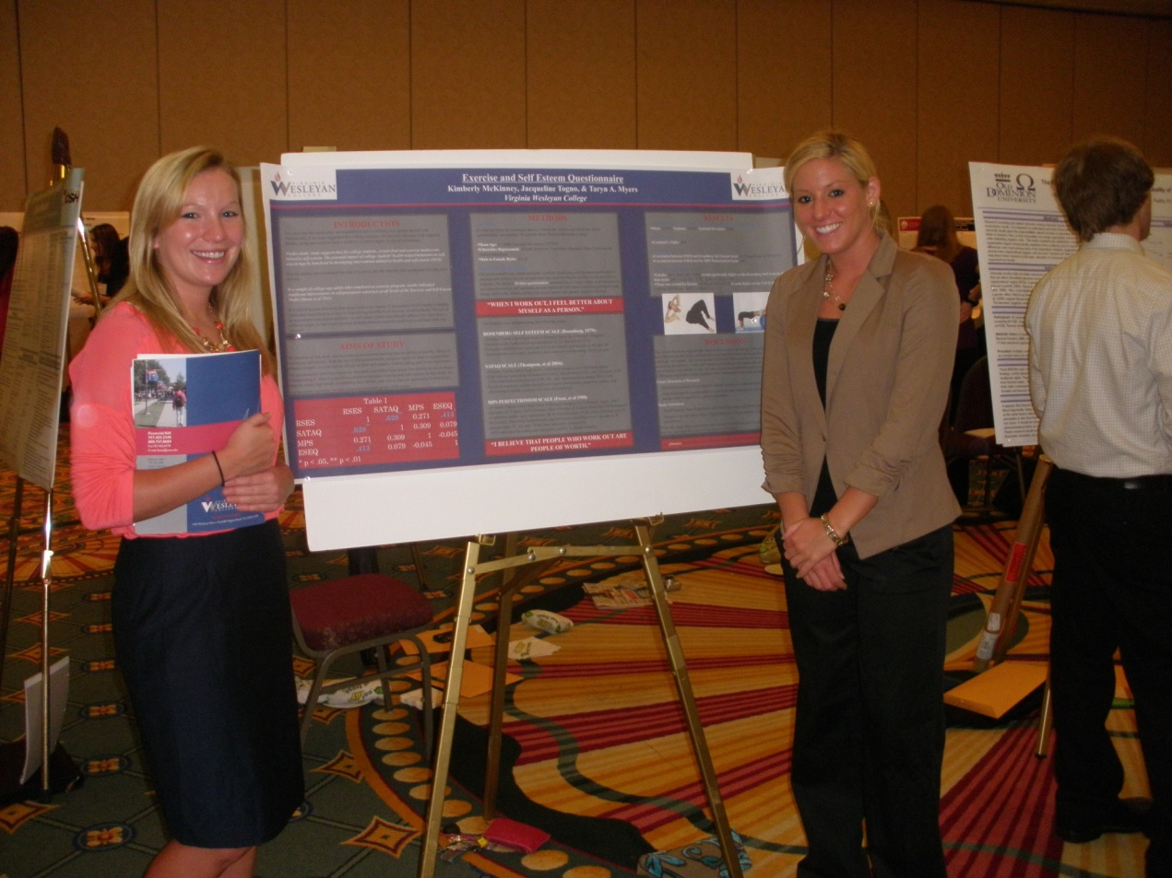
Research Independent Studies
Process
  Proposal/Design
  IRB approval
  Data collection
  Final product
Considerations
  Course credit
  Deadlines
  Goals
  Evaluation
  Beyond the class

Slide 11
Required Capstone Research Project

Slide 12
Our Research Sequence at Virginia Wesleyan
Psy 210 Statistical Analysis in Psychology → lay foundations
  Prereqs:
    Sophomore/Junior Status
    Declared Psychology Major
    Appropriate math placement (A, B, or H) or Math 104 with C- or better
Psy 320 Research Methods in Psychology → write proposal
  Prereqs:
    Junior Status & at least 8 hours in Psychology
    Psy 210 with a C- or better
Psy 480 Original Research Project → conduct research
  Prereqs:
    Senior Psychology Major
    Eng 105 with a C or better
    Psy 320 with a C- or better
    Approval by project advisor

Slide 13
Psy 480
Students in this course will complete an independent research study on some topic in psychology. The major steps involved for successful completion of this project include:
  attend all seminar meetings and workshops
  prepare and submit an IRB proposal
  prepare study materials
  participant recruitment and data collection
  prepare a formal research paper in APA style on the basis of your study
  present and defend your work in an oral examination

Slide 14
Pros & Cons
Pros
  All students get first-hand research experience
  Rewarding
  Presentations
    On campus (Port Day/Undergraduate Research Symposium)
    Off campus (VAPS)
  Occasionally publishable
Cons
  Like supervising 6-8 independent studies
  Very time intensive
  Often not related to your interests
  Challenging with some students

Slide 15
Benefits & Challenges

Slide 16
Benefits of student research
Experience for students
New research ideas
Improves your productivity
  Only in certain cases

Slide 17
Challenges of student research
Best laid plans
Deadlines
Can add to your workload
Different ideas
Authorship

