Slide 1

Welcome to the 2016
CPLAC SIG Meeting!

Slide 2
Today’s Agenda
Membership Renewal and Dues
Program Committee Interest
Review of 2016 Goals and Accomplishments
Student Awards and Presentation
Member-led Discussion:
  “Research Collaboration Across Liberal Arts Colleges”
Announcements on remaining ABCT activities for CPLAC
Sarah: final officer nominations, voting, and planning for next year

Slide 3
Membership Renewal
$10 faculty
$5 students
Cash to Ashley Borders now (or Paypal to new treasurer by Jan 1 if able!)

Slide 4
Do you have interest in serving on the Program Committee?

Slide 5
Goals & Accomplishments
Goal #1: Increase visibility within ABCT
  Another panel accepted! (and 3 submitted total!)
    A big thanks to Jo and last year’s officers for efforts to rectify previous submission problems!
  Several members (with more coming) on Program Committee
  Several members published in tBT
  President involvement with SIG leaders group
  Another round of great posters for the Cocktail Hour
  Continued use of logo

Slide 6
Goals & Accomplishments
Goal #2: Increase SIG-related activity at ABCT
  90 vs. 60-minute business meeting
  Experimental social gathering
Goal #3: Expand and improve website
  Thanks to Laura for working with other officers to update member resources, student resources, accessibility and for improving formatting

Slide 7
Goals & Accomplishments
Goal #4: Streamline membership and dues process
  Thanks to Ashley for working with me on these plans, as reflected on the website!
Goal #5: Further develop based on member ideas
  Discussion of research collaboration here today
  Helping students link up to attend conference
  Keep the ideas coming!

Slide 8
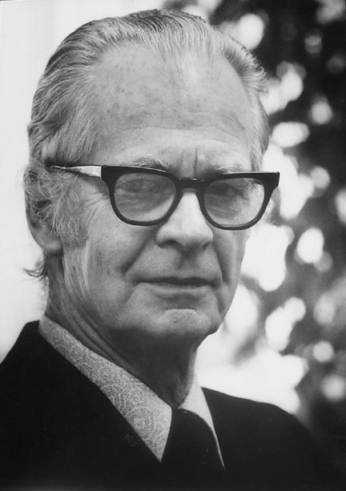
In addition to our SIG accomplishments, our members have been very productive as well…
You’re
amazing!

Slide 9
Student Poster Awards
CONGRATULATIONS!
Monica Abdul-Chani & Gabriella Ponzini (mentored by Brandon Gaudiano & Casey Schofield) of Skidmore College for their project:
”Evaluating the Impact of Etiological Explanations for Social Anxiety Disorder”

Slide 10


Evaluating the Impact of Etiological Explanations for Social Anxiety Disorder
Monica Abdul-Chani¹, Gabriella Ponzini¹, Brandon Gaudiano², & Casey Schofield¹
¹Skidmore College
²Brown University
CPLAC SIG
ABCT, 2016

Slide 11
Implication of Biological Explanations
In recent decades, public attitudes about the perceived cause of mental disorders have shifted.
(Pescosolido, Martin, Long, Medina, Phelan, & Link, 2010)
Theoretical models propose that this shift will impact perceptions in various ways:
    Attribution theory
  (Corrigan, 2000)
    Mixed-blessings model
(Haslam & Kaavale, 2015)
Notes:
BULLET 1
Lay-people tend to endorse biological and genetic explanations as the cause of mental health problems at significantly higher rates than in the past, and there has been an increasing interest in the consequences of this shift for both attitudes towards these disorders and attitudes towards various treatment approaches.
BULLET 2
Theoretical models propose that this shift will impact attitudes towards mental disorders in various ways:
FIRST SUB-BULLET
Attribution theory posits that such a shift may have beneficial social consequences given that biological explanations for symptoms arguably conceptualize sufferers as blameless victims of biology, as opposed to blame-worthy agents in their symptoms (Corrigan, 2000).
SECOND SUB-BULLET
The mixed-blessings model proposes a more nuanced perspective, arguing that biological explanations promote essentialist thinking (DEFINE) that has both pros and cons in terms of public attitudes:
The advantage is that patients will be assigned less blame for their symptoms (consistent with the predictions of Attribution theory)
The disadvantage is that essentialist thinking will promote desire for social distance, perceptions of dangerousness, and prognostic pessimism will increase.
Given the growing pervasiveness of biological beliefs about mental disorders, evaluating how broadly this model applies across conditions is of increasing importance.

Slide 12
Previous research
The majority of this previous experimental work has focused on the implications of a biological framework for depression and/or schizophrenia. (Lebowitz, 2014; Angermeyer, M.C., Holzinger, A., Carta, M.G., & Schomerus, G., 2011)
Biological framing may impact the perception of different mental health conditions in different ways. (Lebowitz, 2014; Angermeyer et al., 2011)
Notes:
Credibility:
Reduces blame attitudes
General shift in the public towards this explanation
Stigma:
Desire for social distance increases, perceptions of dangerousness increase
Prognostic Pessimism:
Greater pessimism about illness prognosis
Tx Attitudes:
Perception that medication would be most/more helpful increase

Slide 13
Biological Explanations and Social Anxiety Disorder (SAD)
Only two studies have assessed the impact of biological framing on SAD.
  (Lebowitz & Ahn. 2014; Lee, Farrell, McKibbin, & Deacon, 2016)
No previous work has tested the impact of framing on treatment attitudes.
Goal of current study was to understand the potential role that framing plays in promoting or undermining stigma and treatment perceptions among laypeople.
Notes:
GENERAL START:
Little work has focused on the implications of biological causal beliefs on the anxiety disorders, even though these conditions are among the most common and costly mental disorders.
In particular, only two studies have tested the impact of biological framing on SAD.
BULLET 1:
The first study was conducted with mental health clinicians and suggested that biological framing may decrease empathy towards patients and reduce perceptions of the effectiveness of psychotherapy among clinicians (Lebowitz & Ahn, 2014).
The second study was conducted on individuals with clinically significant SAD symptoms. And found that biological explanations yielded lower self-stigmatizing attitudes than either a cognitive behavioral (CB) condition or a combination (CB + bio) condition (Lee et al., 2016).
NEITHER of these previous studies tested the impact of biological framing on lay-people, or assessed the impact of biological framing on treatment attitudes.
BULLET 2:
Interested in the potential impact of these frames on attitudes towards treatment since treatment for anxiety disorders has shifted dramatically towards a medication as monotherapy approach in the past 20 years (I have some slides from the CBT framing talk that you may want to include here that illustrate this shift).
Understanding the potential impacts of biological framing on expectancies for treatment outcome is important given that negative expectations about treatments can be a barrier to treatment for anxiety (Johnson & Coles, 2013) and predictor of treatment outcome.

Slide 14

Study Participants
N = 205
54.1% Male, 44% Female, 1.9% Abstained
Age M = 31.97, SD = 11.66
Race:
70.2% White
10.7% Black or African Amer.
11.7% Asian
2.4% Bi/Mutli-racial
1.0% Hawaiian or Pacific Islander
2.4% “Other”
1.5% Abstained
Sample was moderately symptomatic:
mini-SPIN (M = 5.89, SD = 3.62)
Ethnicity:
7.4% Latino/a
Education M = 15.06, SD = 2.17
Notes:
A total of 209 participants were initially recruited using Amazon’s Mechanical Turk (MTurk)
Summarize demographics briefly (“slight more males than females, predominantly white, and with an average of 15 years of education”
All participants completed the mini-SPIN to assess symptoms of SAD and the sample was relatively symptomatic, with an average score of 5.89 (when the clinical cut-off is 6).

Slide 15


Consent &
Demographics
SAD Vignette
Biological
Psychosocial
Biopsychosocial
No Explanation
Dependent Variables
1. Explanation Credibility
2. Attribution of Blame
3. Perception of Tx Effectiveness
4. Perceived Prognosis
Notes:
VIGNETTES:
From Lebowitz & Ahn, 2014
Describes character in general (i.e. symptoms): Nicole
Then randomly assigned to one of four conditions where explanations were given
In the interest of time, we will not be going over the vignettes in detail but do have a slide prepared at the end in case anyone wants to see them.
MEASUREMENT OF DVs:
all of the DVs were single Likert scale items drawn from similar previous work, conducted with vignettes characterizing depression)
HYPOTHESES :
Consistent with previous lit.
biological explanation would be rated as less credible than psychosocial accounts.
both attribution theory and the mixed blessings models, the biological account would be associated with less blame attribution than the psychosocial explanation
there would be congruency between etiological framing and treatment recommendations such that the biological condition would promote perceptions of medication-based treatment.
biological explanation would yield the greatest prognostic pessimism
Good to know this level of detail in case people ask questions, but you don’t need to say all this…
All measured on Likert Scale
Explanation Credibility:
1 item
“How believable does this explanation of Nicole’s symptoms seen to you?”
Likert Scale: 1-5
Stigma:
4 items
Ex.: “To what extent is Nicole personally responsible for her symptoms?”
Ex.: “How willing would you be to work closely with Nicole on a job?”
Likert Scale: 1-4
Tx Effectiveness:
5 items
Ex.: “How effective would you expect medication to be in treating these problems?”
Likert Scale: 1-5
Perceived Prognosis:
2 items
Ex.: “To what extent do you believe that Nicole will eventually recover from these symptoms?”
Likert Scale: 1-5

Slide 16
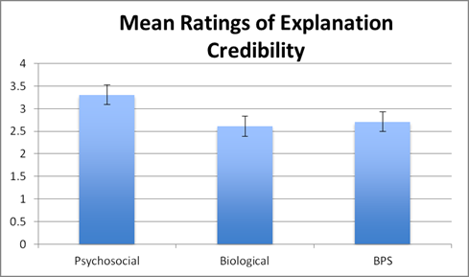
Results: Explanation Credibility
Notes:
One-Way ANOVA
Y-AXIS:
Range of Scale 0-4
X-AXIS:
Condition
Take-Away:
Psychosocial condition had higher ratings for explanation credibility compared to BPS and Bio
Bio and BPS did not significantly differ
There was no control since they did not have an explanation to rate!

Slide 17
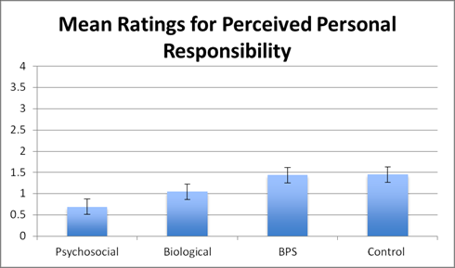
Results: Personal Responsibility
Notes:
One-Way ANOVA
Y-AXIS:
Range of Scale: 0-4
X-AXIS:
Condition
TAKE-AWAY:
Psychosocial condition had lowest rating for perceived personal responsibility compared to the bio, BPS, and control conditions
Bio, BPS, and control did not significantly differ from each other

Slide 18
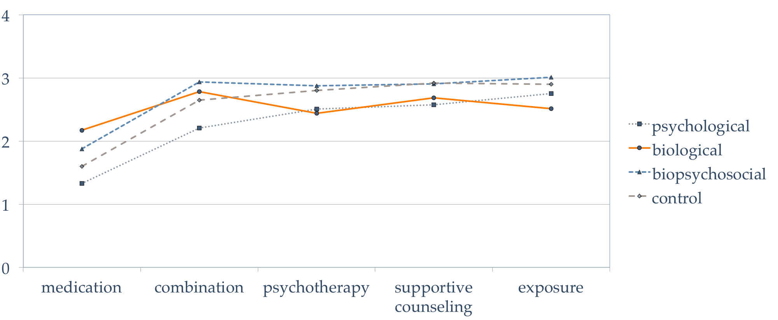
Results: Treatment Effectiveness
Mean Ratings for Perceived Treatment
Effectiveness
Notes:
Y-AXIS:
Range of Scale: 0-4
X-AXIS:
Types of Tx
LINES:
Condition
TAKE-AWAY:
Medication perceived as less effective than all other options
Combo tx was rated as most effective in bio condition, no other significance found in other conditions

Slide 19
Results: Symptomatic Subgroup
Subgroup analyses consisted of participants who reported clinically meaningful symptoms on the mini-SPIN (a score of 6 or higher). (Connor et al., 2001)
Notes:
BULLET 2:
For credibility and prognosis the pattern of results was identical to the full sample.
Analyses of treatment perceptions and personal responsibility showed the same pattern of results as the full sample.

Slide 20
Summary
The psychosocial condition showed higher perceptions of credibility and lower blame compared to other conditions.
Psychosocial condition yielded lowest blame.
The biological condition increased perceptions of the effectiveness for medication, although psychotherapy was still important.
Notes:
Results from the current study provided evidence for both convergence and divergence from previous work.
BULLET 1
Previous work in depression, found that BPS explanations were rated as more credible than the bio (Deacon & Baird, 2009), whereas these conditions did not differ in the current study
May be unsurprising that explanations which included any bio component assigned less credibility in comparison to the psych explanation given that SAD has received less attention than dep in popular media campaigns focused on mental disorders as "brain diseases” and previous work indicating that experts view SAD as less biologically (and more psychologically) sourced than depression (Ahn, Proctor, & Flanagan, 2009)
BULLET 2
The psych explanation appeared to mitigate attributions of blame most strongly compared with the other conditions.
One of most commonly cited justifications for the promotion of bio explanations for MH problems is that such explanations for symptoms will reduce blame attitudes; we failed to find evidence to support this in the case of public stigma for SAD.
Failure to replicate findings for chronicity, prognosis, and social distancing
Public perceptions of SAD may be different in comparison to other MH problems.
A lot of variability in how prognosis is measured across many studies; we assessed chronicity and recovery likelihood which was different than other studies so results may not reflect the previous constructs that were measured
We looked at public stigma versus self-stigma
BULLET 3
Bio condition increased perceptions of the effectiveness of medication
For all other conditions medication was viewed less favorably compared to other tx, consistent with evidence of a general preference for psychotherapy

Slide 21
Limitations
Computer-based limits reach to populations without access.
SAD sample was symptomatic but not diagnosed.
Implications for behavior outside this experimental work is unclear.
Notes:
BULLET 1:
Study done on Mturk
BULLET 2:
mini-SPIN is not a diagnostic tool
BULLET 3:
Lab-based studies with more naturalistic in-person assessments may be of particular value as such work does not adequately address the impact of symptom framing on real-world behavior such as treatment choice.

Slide 22
The Take-Away
Biological framing promotes perceptions of pharmacological treatment in SAD.
Appears to impact perceptions of credibility and stigma differently compared to other mental disorders.
Notes:
BULLET 1:
Replicated results from previous studies in both SAD and other conditions that framing symptoms biologically appears to promote the perception of medication-based treatment.
BULLET 2:
Impact of causal explanations may differ across disorders in other important ways – SAD biological framing did not reduce perceptions of blame and was associated with relatively low credibility compared to other explanations.
GENERAL TAKE-AWAY:
The results of this study speak to the dangers of generalizing results from previous research to mental disorders as a whole.
Given the biological shift in perspective, it is important to understand the implications of these attitudes across disorders
Both in terms of public attitudes and tx practices

Slide 23


THANK YOU!
Monica Abdul-Chani
mabdulch@skidmore.edu
Gabriella Ponzini
gponzini@skidmore.edu
Cognition, Affect, and Treatment Attitudes (CAT) Lab
Director: Casey A. Schofield, PhD
https://academics.skidmore.edu/blogs/catlab/

Slide 24
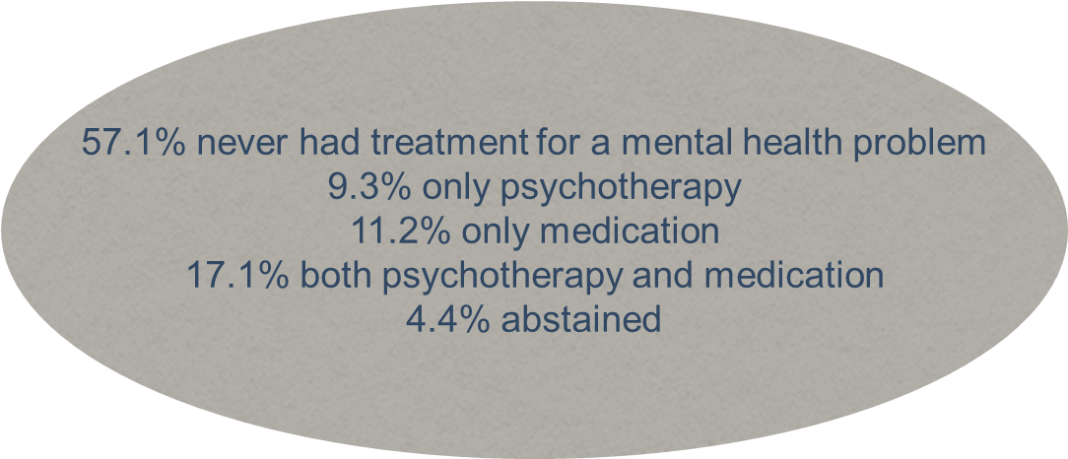
Other Information
Exploratory mediation analysis was not significant in the symptomatic subgroup.
Notes:
Testing credibility as a mediator of the relationship between condition and perceived responsibility

Slide 25
Descriptor Vignette
Nicole is a 21-year-old college student who has decided to seek treatment for what she calls “crippling shyness.” For many years, she has felt extremely nervous any time she has had to speak in front of a group or meet new people. This has made it very difficult for her to form new friendships, give presentations as part of her coursework, or even participate in classroom discussions. She is always afraid that she will embarrass herself or that others will judge her negatively. Her overwhelming shyness has gotten much worse in recent years; she is now careful not to take any courses that require class presentations and avoids almost all situations in which she might have to meet new people.

Slide 26
Psychosocial Vignette
When she was young, Nicole was overweight and wore thick glasses. Because of this, other children in her classes frequently teased and bullied her. Although she had a few friends during her childhood, she often felt like an outcast, and the older she got, the fewer friends she had. Nicole is an only child, and her parents both worked long hours when she was growing up. As a result, she often had no one to talk to about the problems she was experiencing. She feels that she may have never really learned to confide in or trust anyone.

Slide 27
Biological Vignette
Nicole’s mother has commiserated with her about her shyness, explaining that she was extremely shy too when she was younger, and has even conjectured that shyness might run in her family: after all, her mother and brother also had similar problems. Nicole’s mother reports that a doctor once told her she probably had low levels of a chemical called serotonin in her brain. Nicole recently underwent an fMRI scan when she participated in a research study, and the technician noticed that her amygdala—a part of the brain important in fear—was more active than an average person’s.

Slide 28
Biopsychosocial Vignette #1
When she was young, Nicole was overweight and wore thick glasses. Children in Nicole's classes frequently teased and bullied her. She felt like an outcast, and the older she got the fewer friends she had. She feels she never really learned to confide in or trust anyone. In addition, her mother has conjectured that shyness might run in her family. Nicole recently underwent an fMRI scan when she was participating in a research study, and the technician noticed that her amygdala—a part of the brain important in fear—was more active than an average person’s.

Slide 29
Biopsychosocial Vignette #2
Nicole's mother has conjectured that shyness might run in her family Further, Nicole recently underwent an fMRI scan when she was participating in a research study, and the technician noticed that her amygdala—a part of the brain important in fear—was more active than an average person’s. Further, when she was young, Nicole was overweight and wore thick glasses. Children in Nicole's classes frequently teased and bullied her. She felt like an outcast, and the older she got the fewer friends she had. She feels she never really learned to confide in or trust anyone.

Slide 30
Research Collaborations Across Liberal Arts Colleges
Helen Z. MacDonald, Ph.D.
Emmanuel College
Notes:
My name is Helen MacDonald. To briefly introduce myself and give you a bit of context for what we’ll be talking about today, I’m in my 5th year in a TT assistant professor position at Emmanuel College which is a small liberal arts college in the center of Boston.
Today, I’m going to talk about my experience forging a research collaboration with another colleague at a small liberal arts college and what that experience has been like. Then, I’m hoping to spend the majority of our time together today discussing a topic related to research collaboration that will be of interest to the group. After having introduced my experience with research collaboration, I’ll propose a few possible discussion topics, and we can vote on one to discuss. We’re hoping that we can leave the meeting today with some concrete, actionable steps in the direction of research collaboration within our SIG, but I’ll leave it to our group to brainstorm what form, specifically, that might take.
So to launch into my particular experience in this area: My college has a 3-3 teaching load. Emmanuel emphasizes teaching but also has a strong commitment to scholarship, and most of my colleagues aim to publish 1-2 papers a year.

Slide 31
My experience
Expanded on an existing research collaboration with a LAC colleague
Developed a research project incorporating common interests and those specific to our research lines
Collaboratively drafted IRB correspondence, created an assessment battery, formatted our survey in qualtrics
  Each participant received ICF for his/her institution and was then routed to our common survey
  Survey diverged again at the end, awarding research participation credit in different ways for each institution
  Survey administration was simple and FAST
Notes:
B1: When I started at Emmanuel I was 5 years post-doctoral, and I was fortunate to have a longstanding research collaboration in place with a colleague who is a faculty member at a small liberal arts college very similar to Emmanuel, but in another part of the country. We both trained at the NCPTSD and share many similar research interests.
During the first years of our collaboration, during my postdoc at the NCPTSD and the early years of my time at Emmanuel, our work together centered around secondary data analysis using data from large, pre existing datasets available through my postdoc, and we had never ventured into the world of data collection together.
Then, two years ago, Jen suggested that we develop our own study and collect data across our campuses, which were similar in many ways, but also complementary in other ways. I jumped at the opportunity, and I’ll talk a bit more about why when I discuss what I see as the advantages of this arrangement.
B2: We began by working on developing a research project incorporating both our common interests, as well as those interests that are specific to our individual lines of research. So, in our case, we shared an interest in ER, and I have a particular interest in mindfulness, so we measured mindfulness in our study, while Jen has become interested in empathy, so we decided to explore that construct as well.
B3: One of our institutions required a more extensive IRB process, so we worked on tackling that one first, together, and then were able to use much of that material for the other institution’s IRB. We created an assessment battery, and imported our survey into qualtrics, with the help of our RAs. As we received correspondence from the IRB from each institution, we would send it along to the other institution, as FYIs, particularly when we received approvals.
I’m sure many of our institutions use qualtrics, and we found this to be a great platform for our survey. The survey was conducted entirely online, and each participant received the ICF for his/her institution (along with other information specific to his/her institution, including counseling center phone #, etc.), and was then routed to our common survey. We were able to create a separate path at the end of the survey, so that participation credit could be awarded in different ways for the Emmanuel College students and for the GC students.
The administration of the survey was simple and seamless and FAST. We both work at small colleges, so it was exciting for us to be able to collect a relatively large sample over a short period of time. (> 600 participants across two semesters)

Slide 32
Advantages
Fostering collaboration across institutions
Working with a colleague with shared interests
Minimizing research isolation
Collecting a large, balanced, and diverse sample!
Increasing productivity
Notes:
Fostering collaboration across institutions – cross pollination of ideas.
Working with a colleague with shared interests
I had come from the National Center for PTSD where not only is everyone a clinical psychologist, but everyone has the very same specialty, and where the was an expectation of expertise within this particular area. There are pros and cons to that. I love being in a place where there are so many different domains of knowledge within one department, and where this is a real focus on the liberal arts and multidisciplinary collaboration and exploration.
In contrast, when I began at Emmanuel, I was one of only three clinical psychologists on faculty (which I realize is more than many departments), and each of us had completely different areas of research. This enriches our department in many ways, and provides many advantages to our students, but it means that research collaboration within my department was not necessarily realistic.
So I was really excited about developing and growing some other research collaborations. I found working on a research project with a liberal arts college colleague with shared interests, to be especially rewarding, productive, and effective.
Combatting research isolation
In direct relation to #2, although I am fortunate to be in a supportive, collaborative, and kind department, I find that most of my colleagues and I are islands unto ourselves in our research endeavors. I’m sure that this really varies across institution. I missed having collaborators – very simply! I missed having people to talk with about which measures to select, whether my aims made sense, and, later, which analytic plan I should use. I missed having someone with whom to divide up writing, or editing, and I missed having someone to reality check with me when I got back reviews that were difficult to address.
Collecting a large, balanced, and diverse sample
Collecting data across both of our campuses allowed us to collect a significantly larger sample of participants than either of us would have been able to in a reasonable period of time at our home institution. We have an N of > 600.
In addition, we were able to collect a more diverse and balanced sample that we would have had we been collecting data on our own. My institution is largely female, whereas my colleague’s institution has more men. We have much closer to an even sex distribution than I could ever hope for at Emmanuel. Our sample was more diverse in other respects, as well, given our ability to pool resources and collect data across sites.
Increasing productivity
Because we are collaborating on all of the papers and presentations coming from our shared data collection, we are reaping the benefits of increased productivity. We have each been working in parallel on a first authored paper coming out of the study – the first of which is currently under review. We will also collaborate on presentations from our study.

Slide 33
Discussion Topics
Common participant pool
  What might this look like?
  How might we execute this idea?
Research collaborations with ABCT CPLAC SIG colleagues
  Logistics: How should we help connect members with others with shared interests?
Another topic related to research collaborations of interest to our members
Let’s vote!
Notes:
At this point we’re going to turn to a large group discussion, and we’ll vote on which topic is of greatest interest to the group.
I wasn’t at the conference last year, because I was caring for my newborn, but I understand that one of our members raised the idea of a shared participant pool. We could discuss that – what that might look like, how we might begin to explore executing that idea.
Along the lines of what I just presented, we could talk about other members’ experiences with research collaborations across small liberal arts colleges. If you have had similar experiences – were there additional advantages that you noticed, and, equally importantly, are there limitations or challenges, or pitfalls to be aware of?
If we discuss this, I think we should spend time talking about logistics – how do we – in this larger group – go about helping to connect people with shared/similar interests?
Or is there another topic of interest to the group? Let’s start there. Does anyone have another topic that they’d like to put on the voting list?

Slide 34
Announcements
Our SIG-sponsored PANEL is up next!
  3:00 – 4:30 in Ziegfeld Room (next door)
  “Preparing the Next Generation of Scientist-Practitioners: Disseminating Principles of CBT Through Undergraduate Teaching”
The COCKTAIL HOUR with SIG expo and posters is tonight!
  6:30 – 8:30 in Broadway Ballroom (6th floor)
  Come support our presenters!
Our SOCIAL EVENT is tomorrow!
  4:00 – 6:00 pm
  Playwright Tavern (202 W 49th St)
  A free drink and some appetizers on us!
  Great chance to meet other members and network
  We need feedback on how this goes!

Slide 35
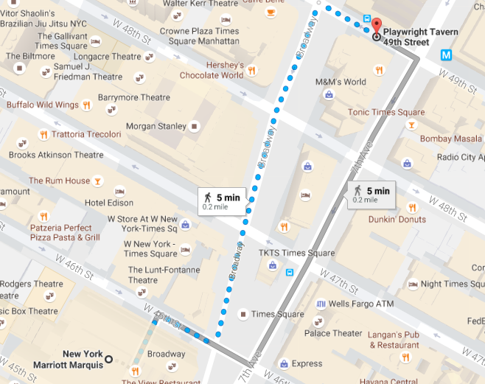

Slide 36

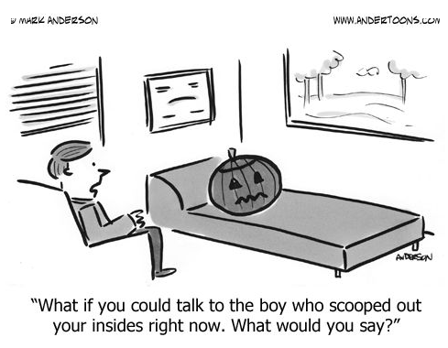
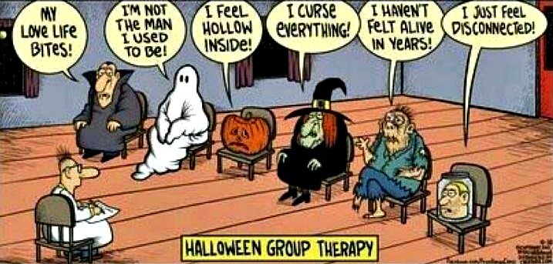


Slide 37
Officer voting and plans for the upcoming year…
Sarah Markowitz, incoming President

Slide 38
THANK YOU!
See you later today or tomorrow! ☺

